Slide 1
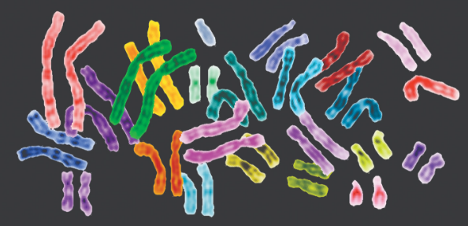

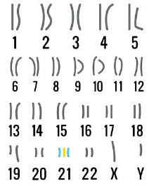
Background & Context
Background: Down syndrome (DS) is a chromosomal abnormality (trisomy of human chromosome 21) associated with intellectual disability and affecting approximately one in 1000 live births worldwide. The overexpression of genes encoded by the extra copy of a normal chromosome in DS is believed to be sufficient to perturb normal pathways and normal responses to stimulation, causing learning and memory deficits.
http://journals.plos.org/plosone/article?id=10.1371/journal.pone.0129126

Slide 2
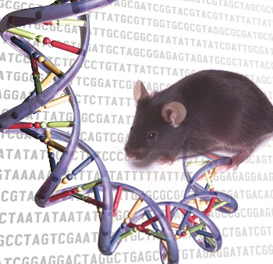
Background & Context
Strategy: Overexpression of chromosome 21, will perturb many different biological processes and pathways including many affecting brain development and function. Because of this complexity, when drug targets, it is logical to consider the downstream, integrated, consequences of all overexpressed chromosome 21 genes i.e., to look for perturbations in pathways that are critical to learning and memory and then to consider drugs that would correct the observed perturbations
Our Task:To build a model using clustering method, identify biologically important differences in protein levels in mice exposed to context fear conditioning (CFC), a task commonly used to assess associative learning.
http://journals.plos.org/plosone/article?id=10.1371/journal.pone.0129126

Slide 3
Analytical Solution
Business Understanding
HTML, CSS,JS
Data Understanding
Data Preparation
Model Development
Address Problems
Basic analysis of dataset, identifying and understanding attributes.
Data cleaning to prepare dataset for model application. Remove useless attributes from dataset, imputed missing values, identified and remove non-correlated features from RFE.
Understand background information and context of data. Identify problem to be researched or addressed.
Ran cleaned dataset through K-means cluster model, PAM, and Hierarchical Clustering models. Assessed the accuracy of each model in application to dataset.
Identified ratio of protein clusters for each test result classification. Clusters were heavily overlapping.
1
2
3
4
5

Slide 4
Data Understanding

Slide 5
Data Understanding: Describing Dataset
The dataset consists of 1080 rows which each contains the expression levels of 77 proteins/protein modifications that produced detectable signals in the cerebral cortex.
There were 38 control mice and 34 trisomic (down syndrome) mice, for a total of 72 mice. Measurements were made using reverse phase protein arrays (RPPA), a technique in which protein samples from individual mice are robotically spotted onto microscope slides to be measured.
For control mice, there were 38x15, or 570 measurements, and for trisomic mice, there were 34x15, or a total of 510 measurements, per protein.
The dataset contains 1396 missing values, there were <15 measurements for a small number of samples/proteins measured.

Slide 6
Data Understanding: Describing Dataset
Attribute Information: 1. Mouse ID 2-78. Values of expression levels of 77 proteins 79. Genotype: control (c) or trisomy (t) 80. Treatment type: memantine (m) or saline (s) 81. Behavior: context-shock (CS) or shock-context (SC) 82. Class: 8 groups of mice described by genotype, behavior and treatment
c-CS-s: control mice, stimulated to learn, injected with saline (9 mice)
c-CS-m: control mice, stimulated to learn, injected with memantine (10 mice)
c-SC-s: control mice, not stimulated to learn, injected with saline (9 mice)
c-SC-m: control mice, not stimulated to learn, injected with memantine (10 mice)
t-CS-s: trisomy mice, stimulated to learn, injected with saline (7 mice)
t-CS-m: trisomy mice, stimulated to learn, injected with memantine (9 mice)
t-SC-s: trisomy mice, not stimulated to learn, injected with saline (9 mice)
t-SC-m: trisomy mice, not stimulated to learn, injected with memantine (9 mice)

Slide 7
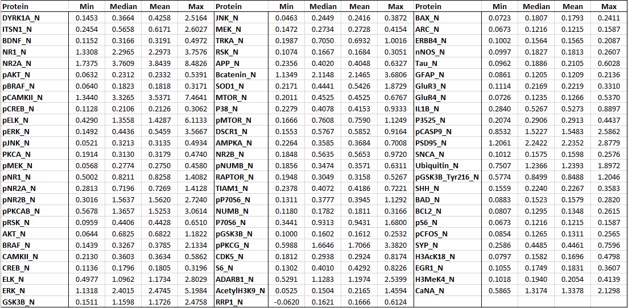
Data Understanding: Protein Summary

Slide 8
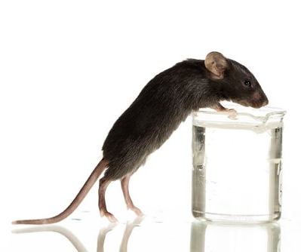
Data Preparation

Slide 9
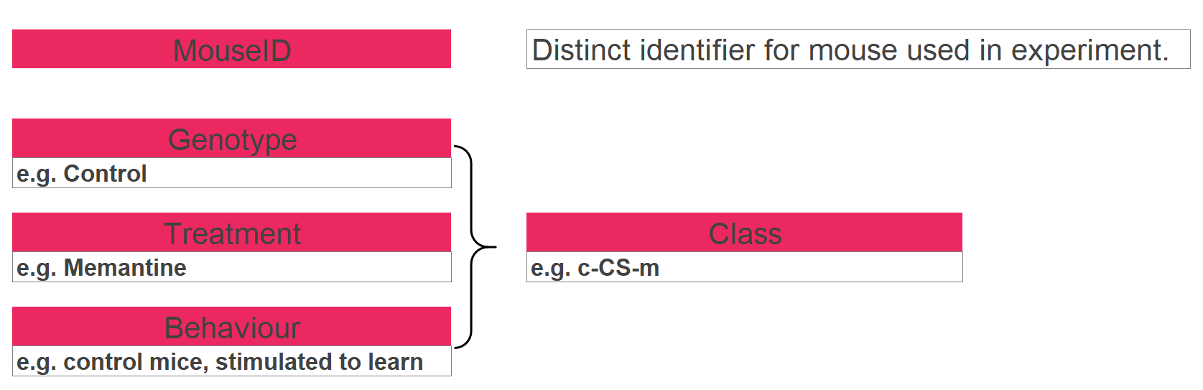
Data Preparation: Feature Removal
Notes:
Unique identified

Slide 10
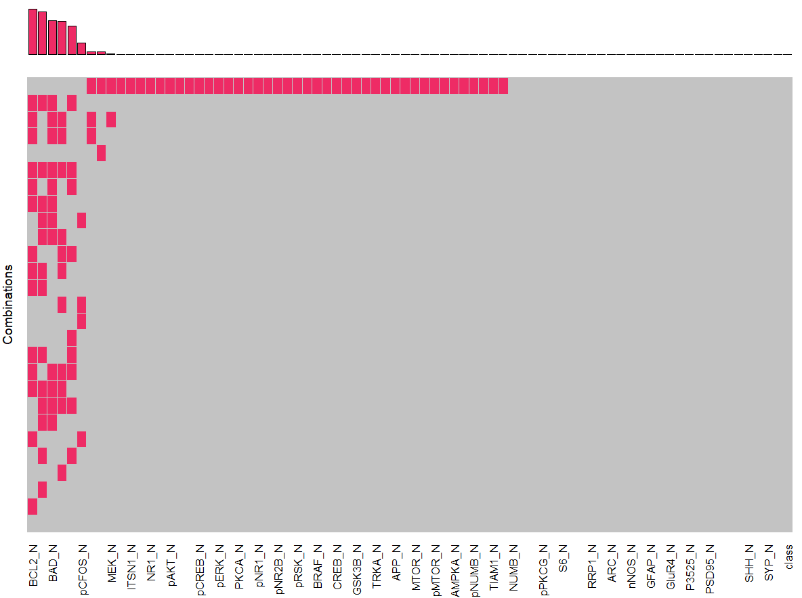
Data Preparation: Missing Values
Identify missing values:
10 features contain missing values
One observation has more than 50% of data missing. ~removed

Slide 11
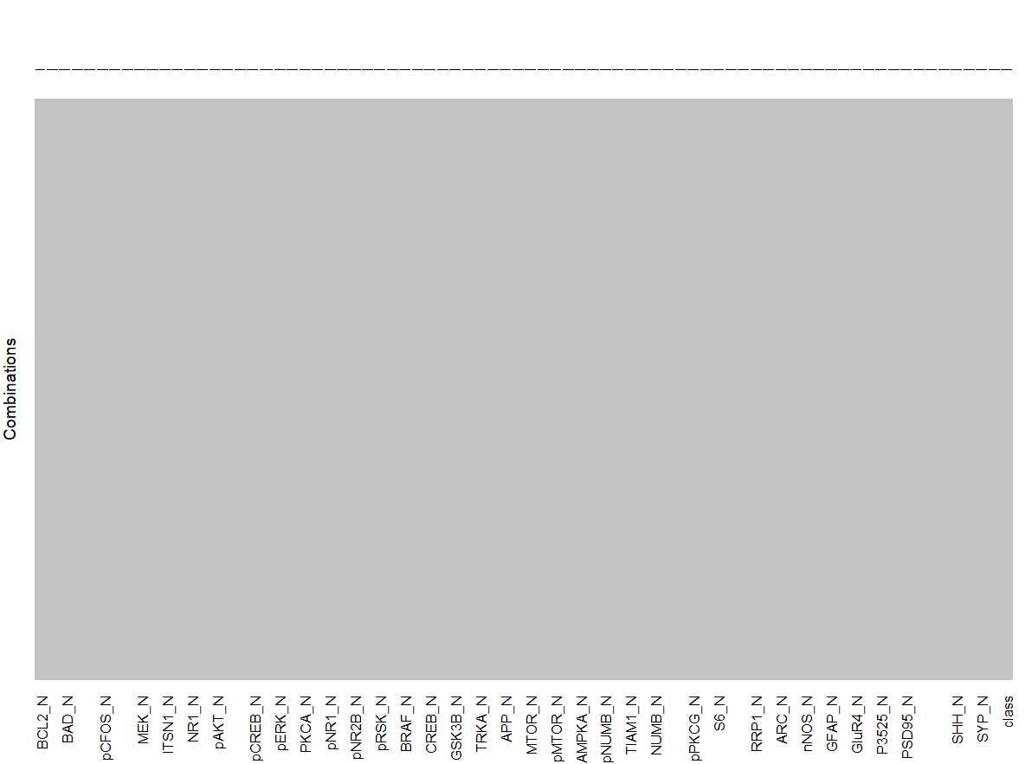
Data Preparation: Impute Missing Values (KNN)
KNN to impute values
#KNN - impute missing values
knnoutput = kNN(mice, k = 5)
summary (knnoutput)
Outcome:

Slide 12
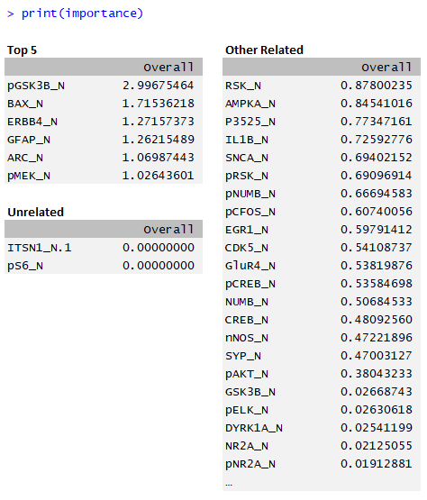
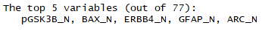
Data Preparation:
Automated Feature Selection
Using RFE algorithm, identify and list proteins in order of importance
control = rfeControl(method = "repeatedcv", repeats = 5, verbose = TRUE, functions = lmFuncs) #define looping functions (5 iterations)
miceRFE = rfe(x = mice.select[,1:77], y = mice.select[,78], sizes = c(1:77), metrix = "RMSE", rfeControl = control)
print (miceRFE)
importance <- varImp(miceRFE, scale=FALSE)
print (importance)

Slide 13
Model Development

Slide 14
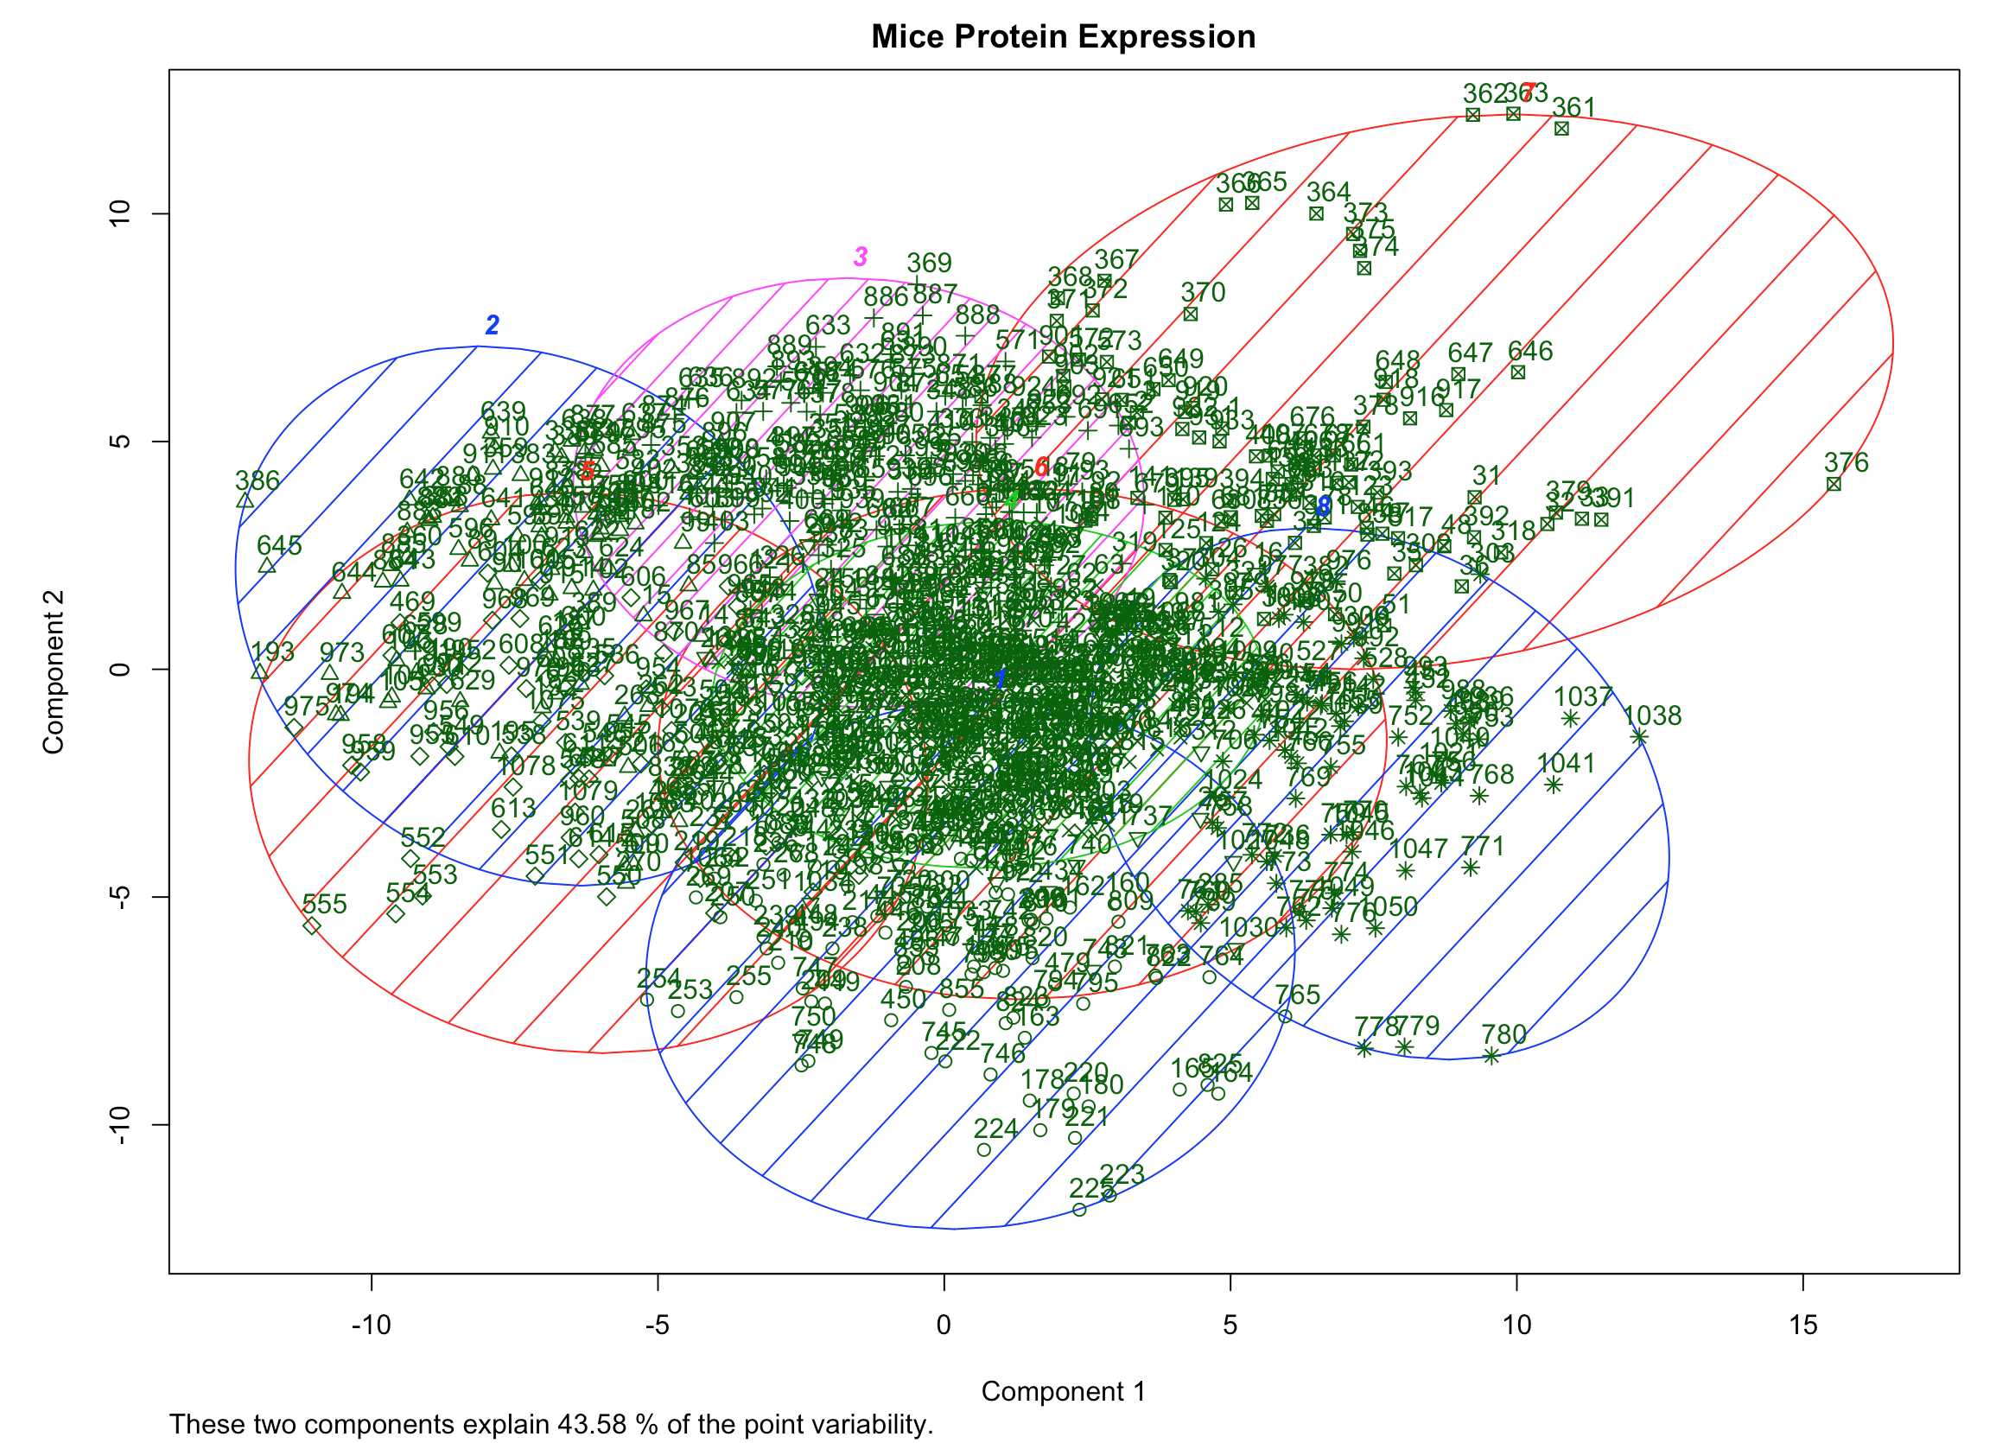
Model Development- K-Mean Clustering
K mean Clustering with 4 clusters
kclust=kmeans(mice.stand,centers = 8 ,iter.max = 100) clusplot(mice.stand, kclust$cluster, color=TRUE, shade=TRUE, labels=2, lines=0, main= 'Mice Protein Expression')

Slide 15
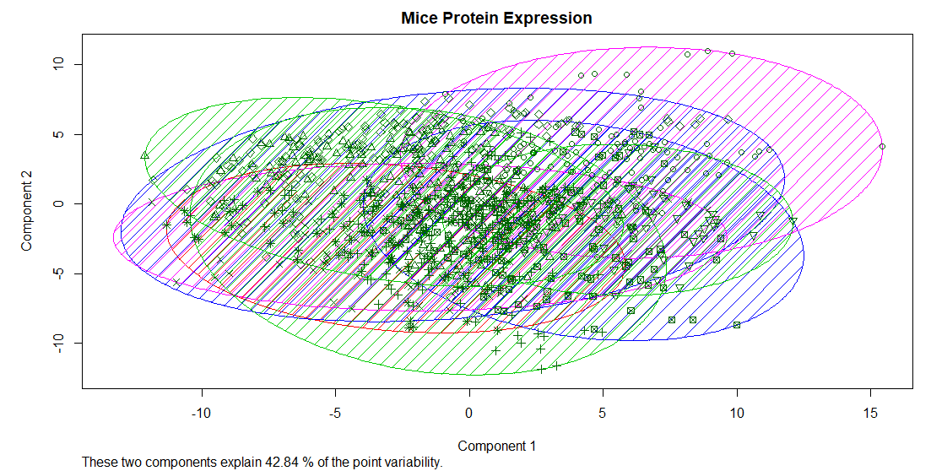
Model Development-Partition Around Medoids Clustering
pr4 <- pam(mice.select, 8)
str(si <- silhouette(pr4))
(ssi <- summary(si)) clusplot(mice.select, pr4$cluster, color=TRUE, shade=TRUE, labels=2, lines=0, main= 'Mice Protein Expression')

Slide 16
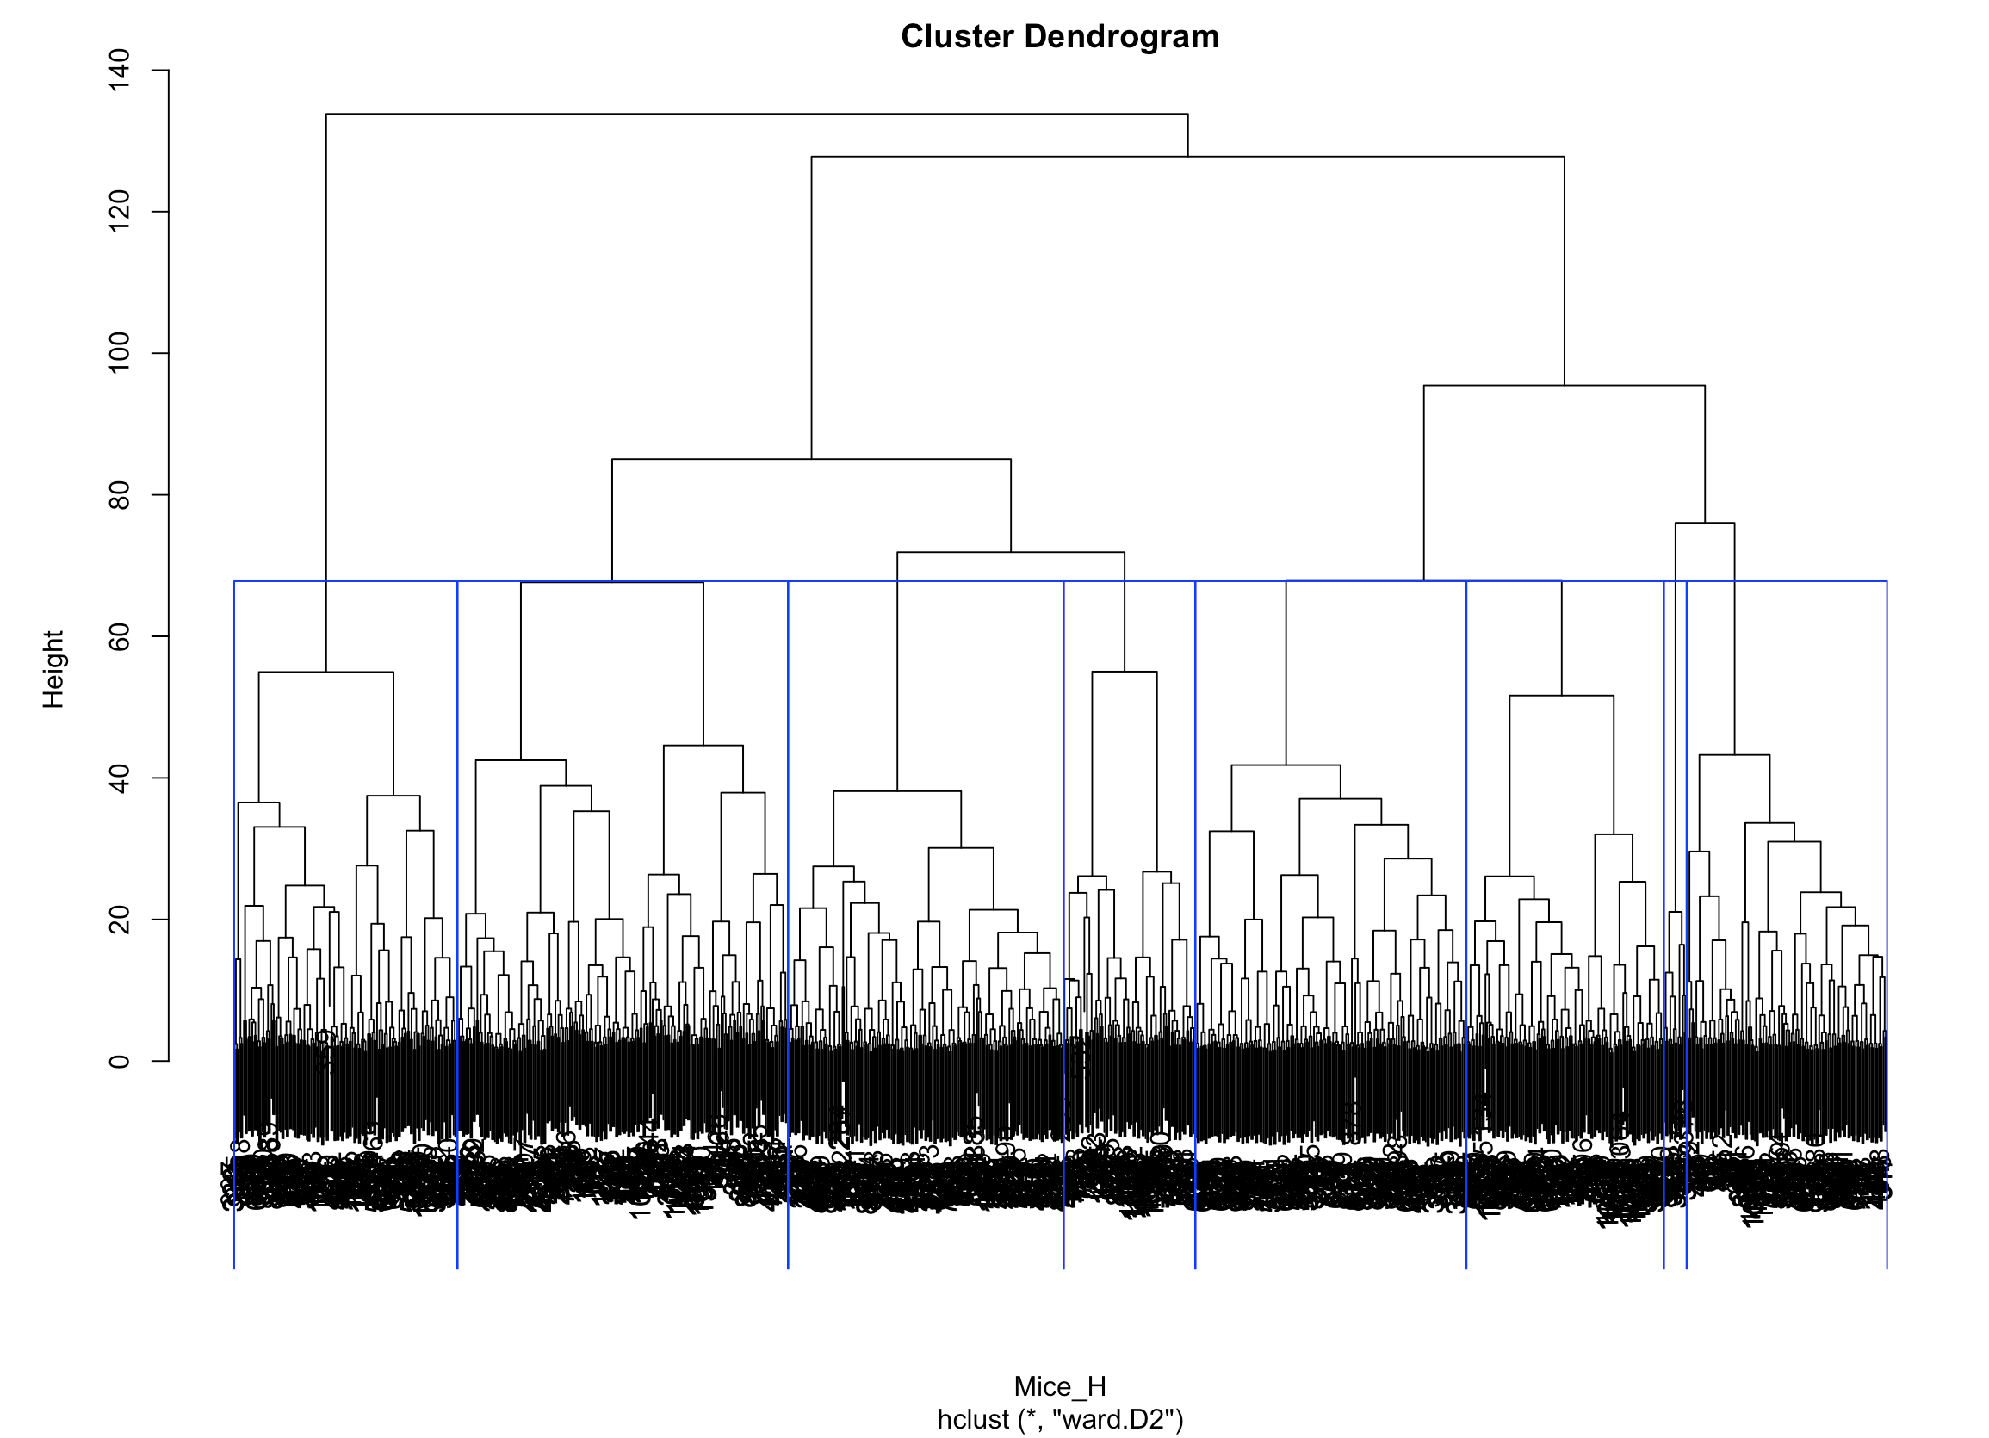
Model Development: Hierarchical Clustering
Mice_H = dist(mice.stand,method = "euclidean")
h_clust = hclust(Mice_H, method = "ward.D2") groups <- cutree(h_clust, k=8) plot(h_clust) rect.hclust(h_clust,k=8,border="blue")

Slide 17
K-Means vs PAM
pr4 <- pam(mice.select, 8)
str(si <- silhouette(pr4))
(ssi <- summary(si))
table(mice.select$class,pr4$clustering)
> table(mice.select$class,pr4$clustering)
1 2 3 4 5 6 7 8
c-CS-m 85 59 6 0 0 0 0 0
c-CS-s 54 77 4 0 0 0 0 0
c-SC-m 0 0 141 9 0 0 0 0
c-SC-s 0 0 15 120 0 0 0 0
t-CS-m 0 0 25 0 100 4 6 0
t-CS-s 0 0 0 0 91 0 13 1
t-SC-m 0 0 0 0 0 25 91 19
t-SC-s 0 0 0 0 0 54 12 69
> table(mice.select$class, kclust$cluster)
1 2 3 4 5 6 7 8
c-CS-m 18 41 47 0 2 11 18 13
c-CS-s 23 24 40 15 1 0 32 0
c-SC-m 22 0 0 0 10 74 4 40
c-SC-s 9 12 0 0 21 69 6 18
t-CS-m 26 11 67 0 17 0 14 0
t-CS-s 17 11 54 0 9 0 11 3
t-SC-m 5 15 0 0 8 58 12 37
t-SC-s 2 33 12 0 47 8 33 0

Slide 18
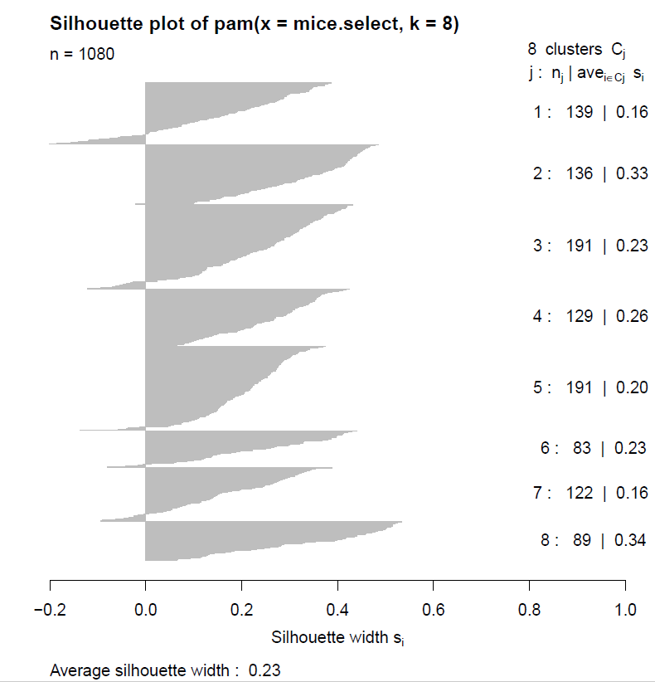
Cluster “Goodness”
Any measure of cluster goodness, or cluster quality, should address the concepts of cluster separation as well as cluster cohesion.
Interpretation of Average Silhouette Value
0.5 or better. Good evidence of the reality of the clusters in the data.
0.25–0.5. Some evidence of the reality of the clusters in the data. Hopefully, domain-specific knowledge can be brought to bear to support the reality of the clusters.
Less than 0.25. Scant evidence of cluster reality.

Slide 19
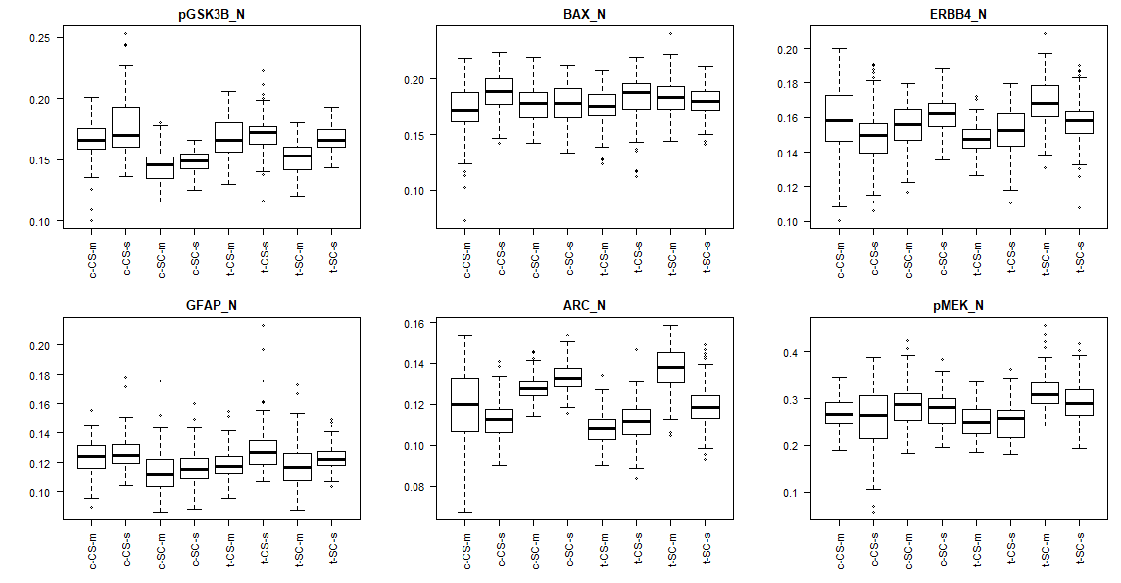
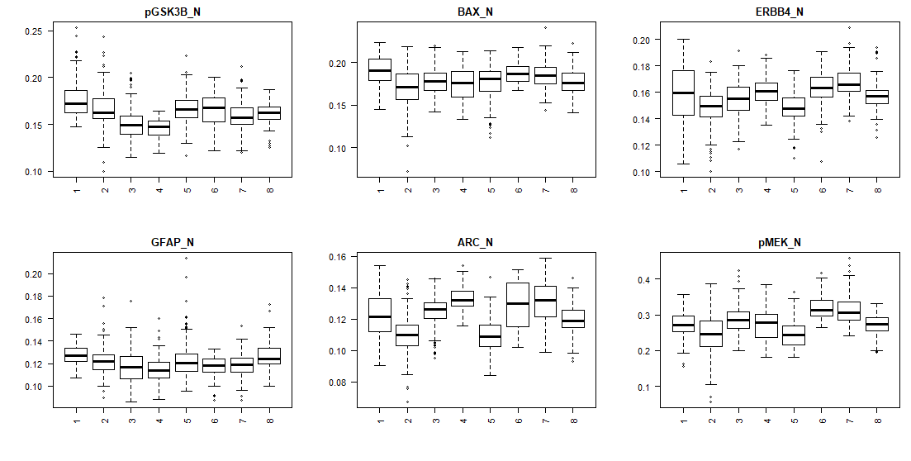
Class vs Cluster
par(mfrow=c(2,3))
for (i in c("pGSK3B_N", "BAX_N", "ERBB4_N", "GFAP_N", "ARC_N", "pMEK_N")){
boxplot(mydata_fit.pam[,i]~mydata_fit.pam[,"pr4.clustering"],main=i,las=2)
}
Comparison of Class to Cluster classification by most relevant protein variables and shows similarities in the breakdown of some proteins, such as ERBB4_N and BAX_N, but also shows that there is some variability, such as pG5K3B_N.
Cluster (pam)
Class
Notes:
For the mice with down syndrome, higher levels of the protein ARC_N, pMek_N, ERBB4_N seemed to be present in subjects that failed to ellicit learning responses while treated with Memantine. Likewise, ARC_N and pMEK_N are in higher concentrations in subjects who failed to elicit a learning response when treated with Saline.

Slide 20
OUTCOME
After running the data through various models, we achieved the best results using the PAM clustering model.
Looking at all the clustering models, one thing we can conclude is that there is a lot of overlap in our dataset. After researching this, we believe this is because the identifiers we are using (proteins) are present in every rat and the variation is merely in quantity of protein. With this in mind, we can understand why the clustering would be so weak when applied to a biological indicator.
For the mice with down syndrome, higher levels of the protein ARC_N, pMek_N, ERBB4_N seemed to be present in subjects that failed to elicit learning responses while treated with Memantine. Likewise, ARC_N and pMEK_N are in higher concentrations in subjects who failed to elicit a learning response when treated with Saline.
This is a possible area of further research and development when treating down syndrome. However, this model does not have a high enough accuracy for medical application at this time.

